Slide 1
FFT Planning and Caribou Mitigation Openings
ARCgis Online
Matt LeRoy, RPB

Slide 2
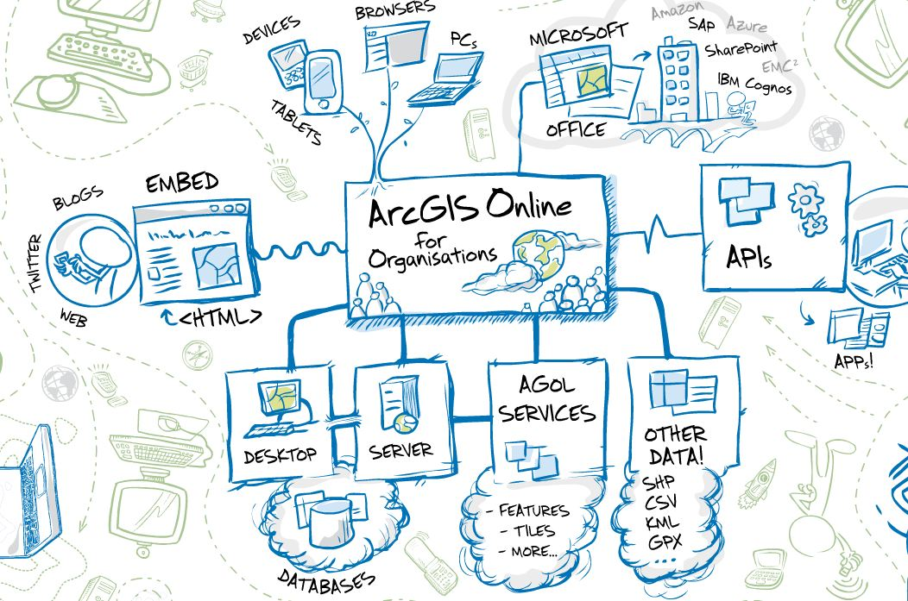
Notes:
This is how ESRI envisions ARCgis online.....the future is bright for AGOL

Slide 3



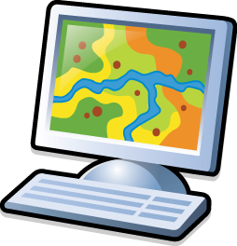

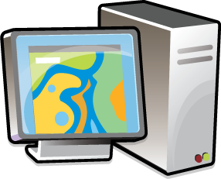

E-mail Map
ArcMap
PDF Maps
Print Map
PC and
File Based
Data Management
GIS Professional
Notes:
Conventional map products, now available online, customizable, queriable etc.

Slide 4




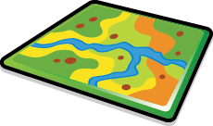



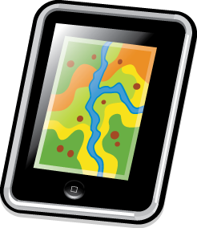



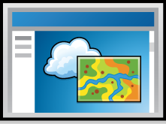
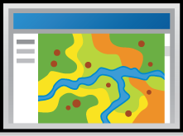



ArcMap
ArcGIS Online
Build One Map!
GIS
Professional
Utilize a number of ESRI Free Apps
Smart Phones and Tablets
Embed interactive Maps in Existing Web Pages
Native Apps from other Software Vendors
Create Custom Web Apps for virtually any Browser
Embed interactive maps in Windows Software Suites

Slide 5
RPB Gallery
ARCgis Map Viewer online
ARCgis Explorer online
  http://rpb.maps.arcgis.com/explorer/?open=d0bc1c57a15a4c40ac0f750cf92d2e6c

Slide 6
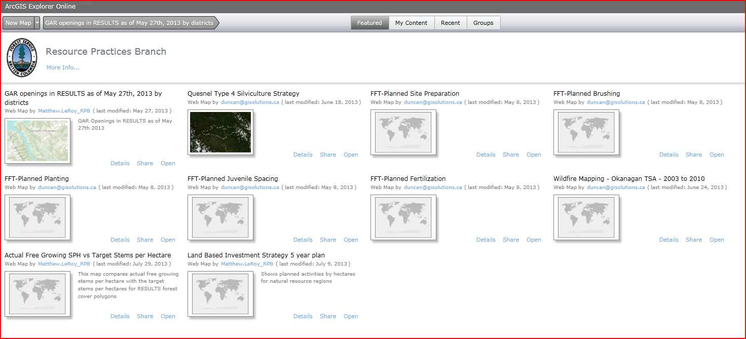
Notes:
The RPB gallery, not just a tool for one project...I will try to do a better job of organizing this

Slide 7
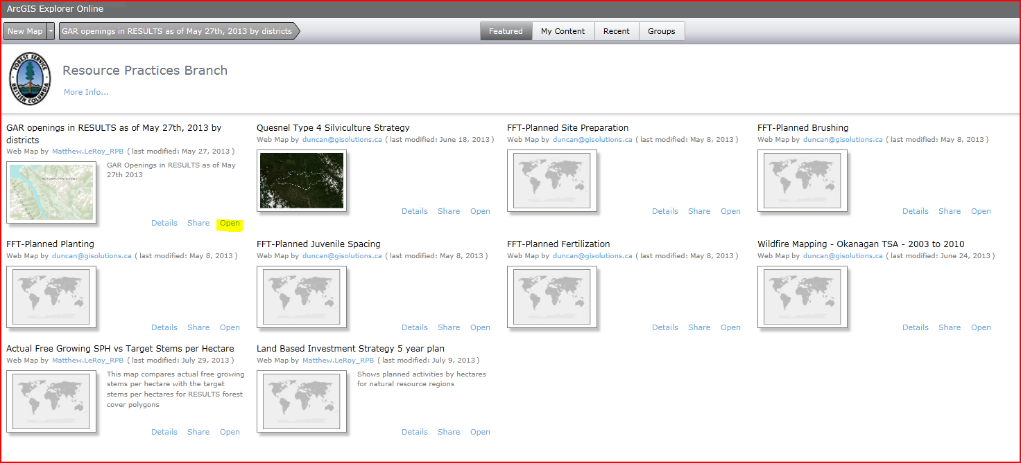

Slide 8
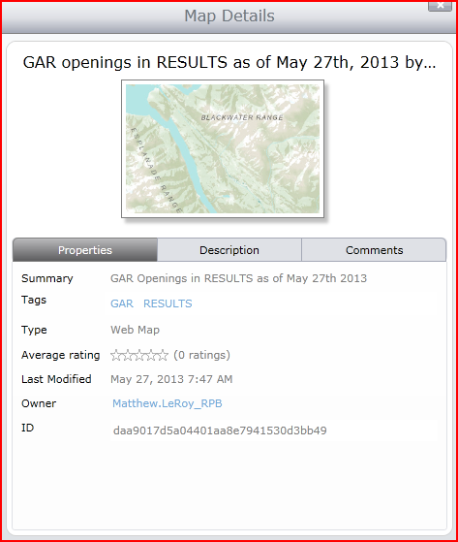
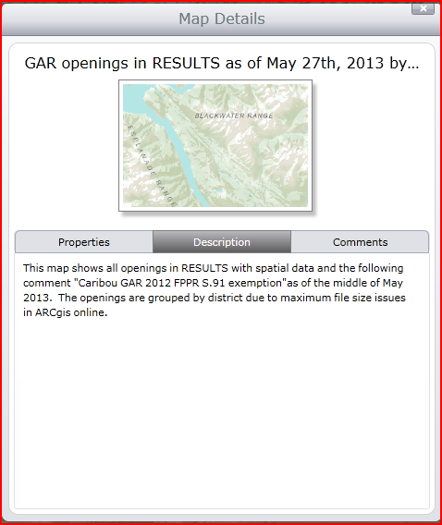
Notes:
Each map in the gallery has background information, contextual information available for it

Slide 9
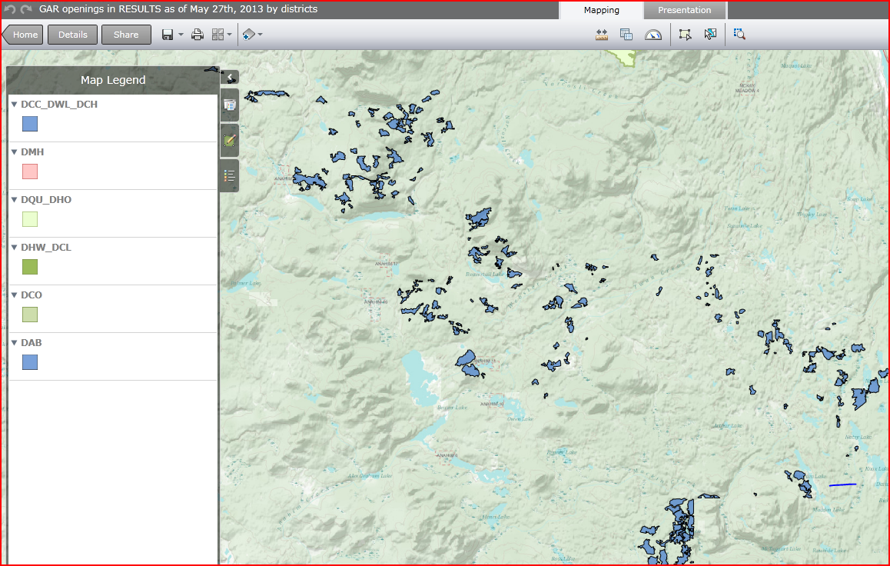
Notes:
Example from the May 27 run, showing Mitigation openings by district

Slide 10
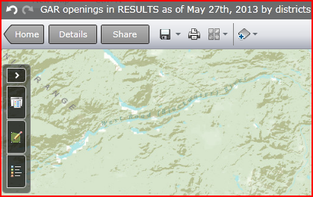
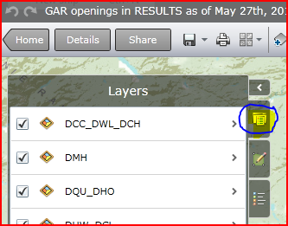
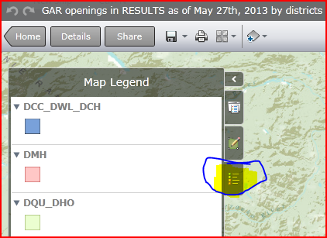
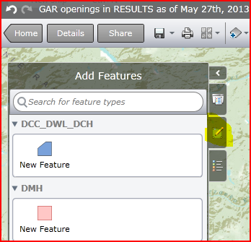
Notes:
Showing the map layers tab, the map legend tab, and the edit features tool...

Slide 11
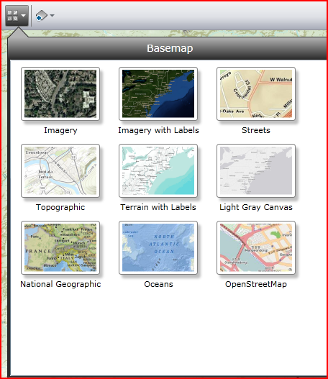
Notes:
You can change the backdrop to your map

Slide 12
Popups – you can configure your own, you could have attachments in popups too, ie. photos
You can change the opacity of a given layer
You can change outline colours and fill colours
You can add bookmark locations
You can print maps, measure distances
You can add your own shapefiles
We can embed a map in a website, easy as pie

Slide 13
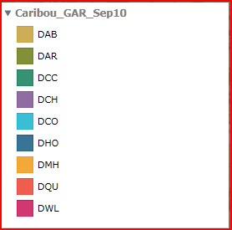
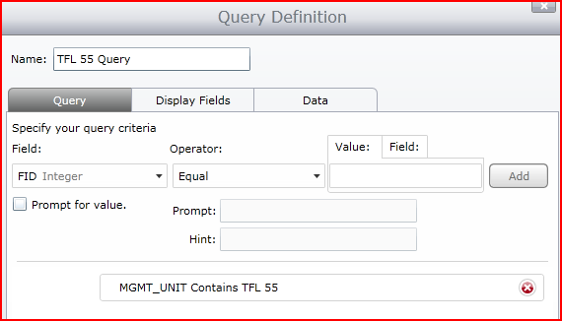
You can symbolize as unique symbols
You can carry out specific queries

Slide 14
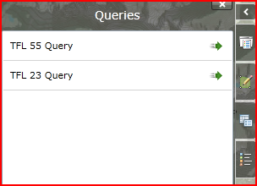
Queries can be saved as layers for future reference

Slide 15
You can add a map service (direct from BCGW)
You can add dashboard stats, to track things like:
  Total area by management unit
  Total costs by management unit
You can embed maps in presentations
We can create our own apps....
  ipads or iphones?

Slide 16


